Slide 1
JAYHIND FOUNDRY
Source of cast iron & S.G iron casting
since 1991
Near Jayhind weight bridge, opp water tank, anil starch road, Memco, Naroda, Ahmedabad-380025.
Contact: 079-22203734
Email : jayhind.jitendra@gmail.com

Slide 2
Vision & Mission
VISION
“Our vision is to create benchmark manufacturing company for foundry industry to produce qualitative casting to satisfied customer through continuous improvement, adopt new technology, team work and creative use of human resource.
Mission
Our mission is to produce 15000 to 18000 MT per annum in the 4 consecutive year through Improvement in technology and process enhancement through which companies will provide the highest quality products to our customers.

Slide 3
Quality policy
We at Jayhind foundry manufacturer of C.I Graded & S.G iron casting, we are committed to achieve enhance the customer satisfaction.
By.
Strictly adhering to the quality management system and process, continuous monitoring and improving for effectiveness.
Produce and supplying consistence material in time bound of customer.
Time bound response to customer complain.
Ensuring good relation with our supplier.
To take effective action to prevent non-conform activity in organization.
This policy will be revised periodically and changed if company’s management require to achieve the given task.

Slide 4
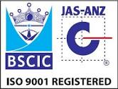
CERTIFICATE
ISO 9001-2015 certified company
BSCIS = BN7510/7389 :1013.
D&B NU = 65-066-7491

Slide 5
INTRODUCTION
Jayhind foundry group is one of the leading manufacturer of cast iron graded & S.G iron casting since 1991.
Producing 1500 MT casting per month.
We have machine molding facility as well as hand molding.
Capacity of producing range of casting from 0.500 kg to 100 kg.

Slide 6
PRODUCTION FACILITY
We have 2 induction furnace of 1MT & 0.5 MT and 4 cupola furnace of different sizes.
We have machine molding of ARPA -450 with atomized sand plant, producing 30 boxes per hour.
Size of mold box 600 * 600 MM
Pin center = 710 MM
Height of box = 200 MM max to 100 MM min

Slide 7
Capacity of machine molding
25-30 Box per hour.
Maximum casting 300 mm height & width 500 mm.
Minimum bunch weight require 20kg per molding.
Minimum order quantity 100 pcs.

Slide 8
Advantage of machine molding
Quantity casting with dimensional accuracy.
Reduce weight with consistency.
Good surface finish.
Reduce machining allowance.
Reduce dependence on labor, so on time delivery to customer.

Slide 9
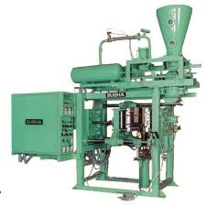
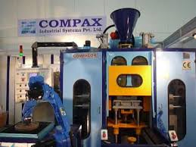
Core making facility
Cold core box process.
Resign core making.
Oil core making.
Co2 core making
Mollasses core making.

Slide 10
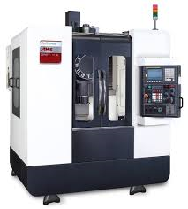
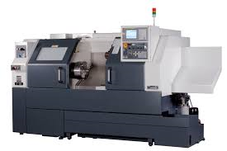
Machining facility
Conventional leath machine.
C N C machine.
V M C machine.
We have develop vendor surrounding our premises for machining. Around 40 vendors.
We can dispach casting with machine with help of our vendors.

Slide 11
Pattern shop
We have own conventional pattern shop in our premises.
We have sub vendor who has C N C and V M C machine for making aluminum pattern for match plate.
By providing drawing or sample we can submit the sample within 25 days.

Slide 12
Facility provided to customer
Provide quality & quantity casting in time.
As per drawing we develop pattern for the party.
Provide services like emery, cheeping, grinding, sort-blasting, Red oxide ( if party require)
Provide machined casting through vendor development.
provide test certificate to customer for grade and mechanical composition of graph, tensile, micro testing etc
Provide facility of third-party inspection.
Quick problem solving
We provide stock facility to customer

Slide 13
Process chart

Slide 14
MAN POWER
We have 600 man power in our group.
70 skilled staff.
14 supervisor.
18 manager..
3 technical staff.
18 admin staff
477 semi skill

Slide 15
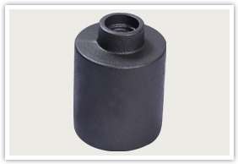
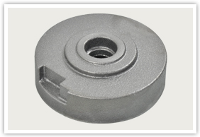
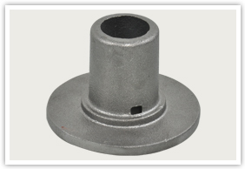
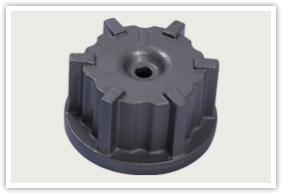
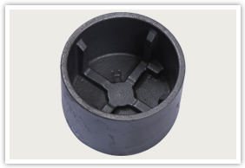
PRODUCT PROFILE

Slide 16
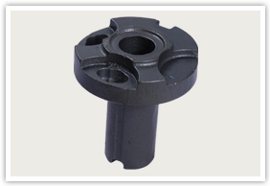
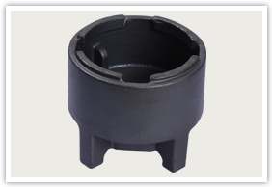
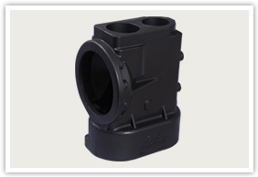
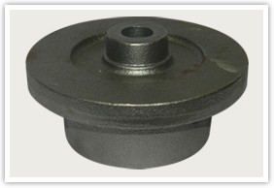
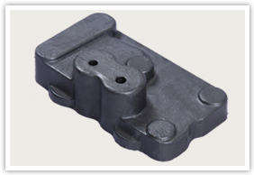
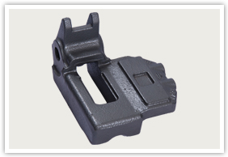
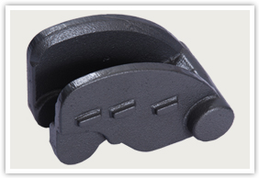
PRODUCT PROFILE 2

Slide 17
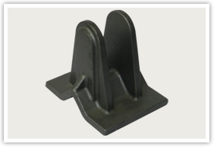
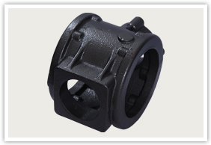
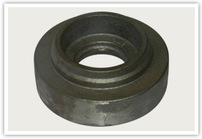
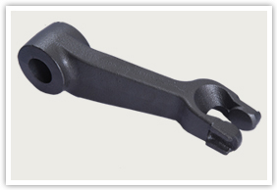
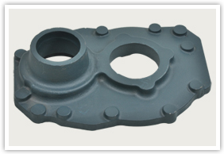
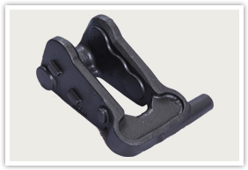
PRODUCT PROFILE 3

Slide 18
Quality instrument Spectro meter

Slide 19
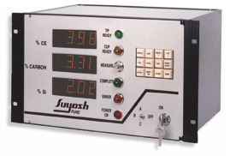
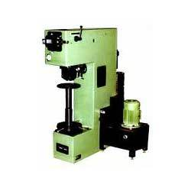
Part-2
Carbon & silicon analyzer.
Hardness tester machine.

Slide 20
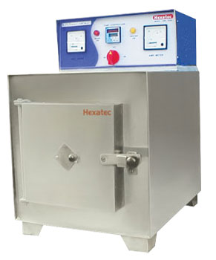
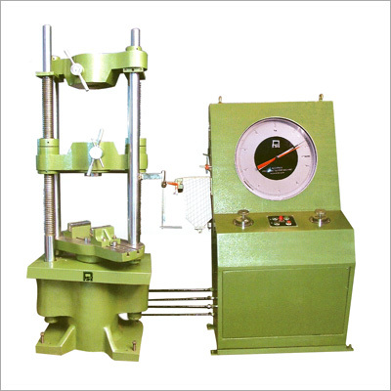
PART 3
Muffle furnace.
Universal tensile machine.

Slide 21
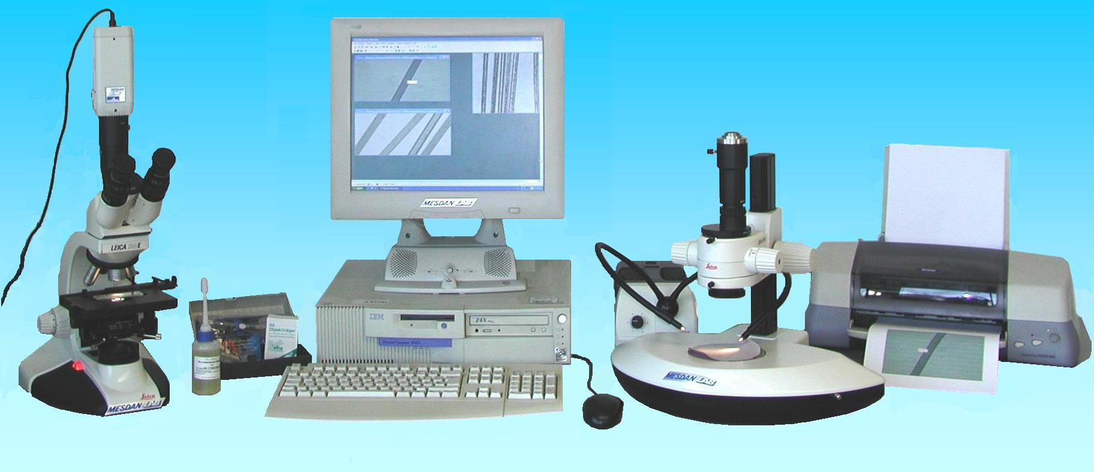
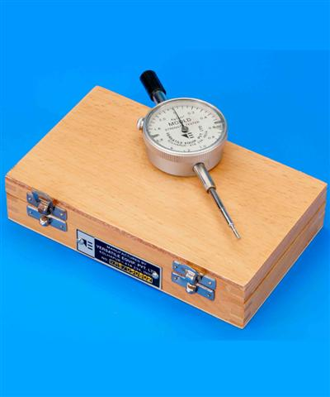
PART - 4
Micro scope analyzer.
Mould harness tester.

Slide 22
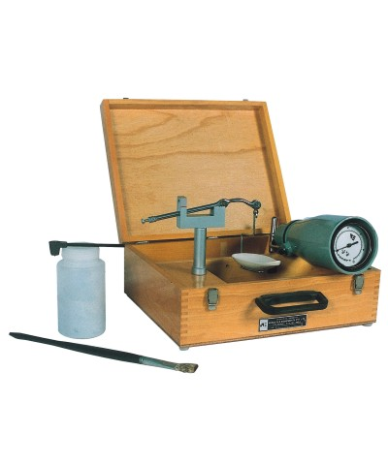
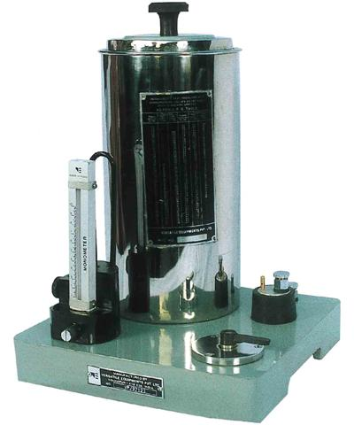
PART -5
Rapid moisture tester
Permeability tester.

Slide 23
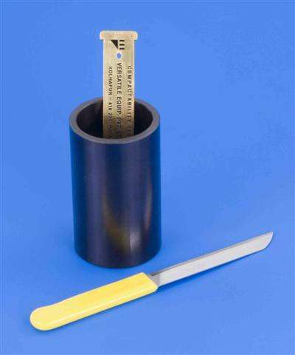
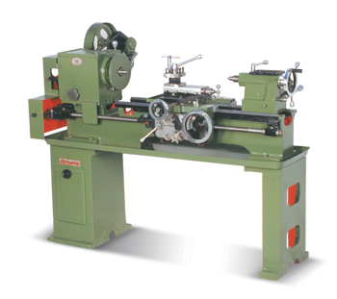
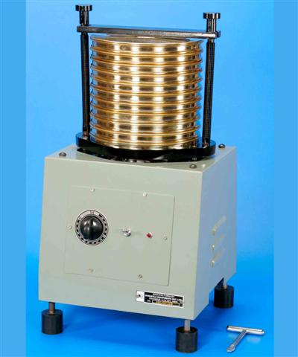
PART -6
Compatibility tester.
Sieve analysis.
Sieve analysis
Lathe machine

Slide 24
JAYHIND FOUNDRY TEAM

Slide 25
LIST OF CUSTOMER

Slide 26
Address & contact
Jayhind foundry
Nr jayhind weight bridge, opp lubi submersible, anil starch road, Memco, Naroda, ahmedabad-380025.
Contact: 079-22203734
09925018933
: kaushal patel
E mail: jayhind.kaushal@gmail.com
kaushal.mba22@yahoo.in
Website: www.jayhindfoundry.com

Slide 27
BILLING & BANK DETAIL
G.S.T NO: 24072600874
C.S.T NO : 24572600874
ECC : ABJPP8101BXM002
BANK DETAIL
BANK OF BARODA
BRANCH : NARODA ROAD
ACCOUNT NO : 08510500018469

